Slide 1
QA Chapter
SEPT EDITION - CPV Tribe - App QA
Notes:
Anton + Paul: WELCOME!
Agenda:
Update from AJ
Engineering metrics
TDD & BDD (Anton note on importance)
Tab count today: 80

Slide 2



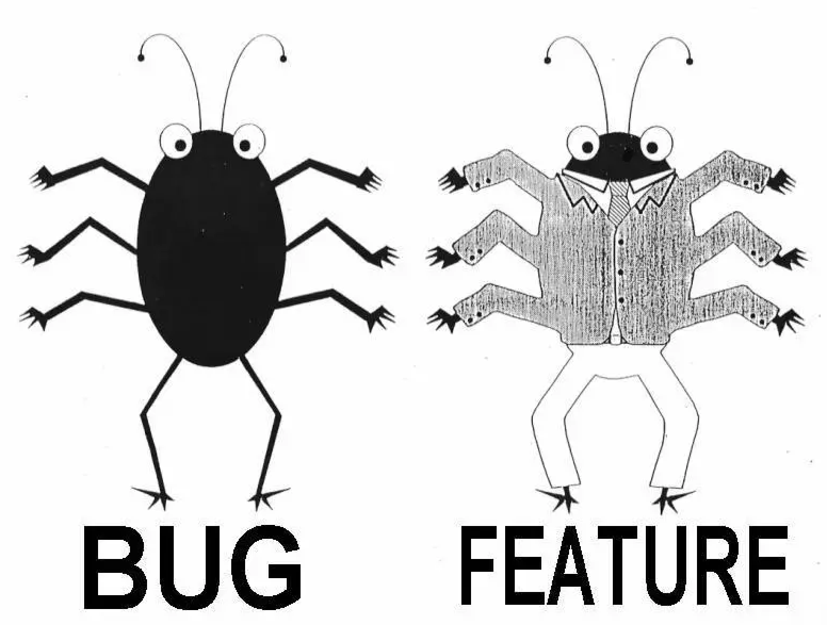

Slide 3
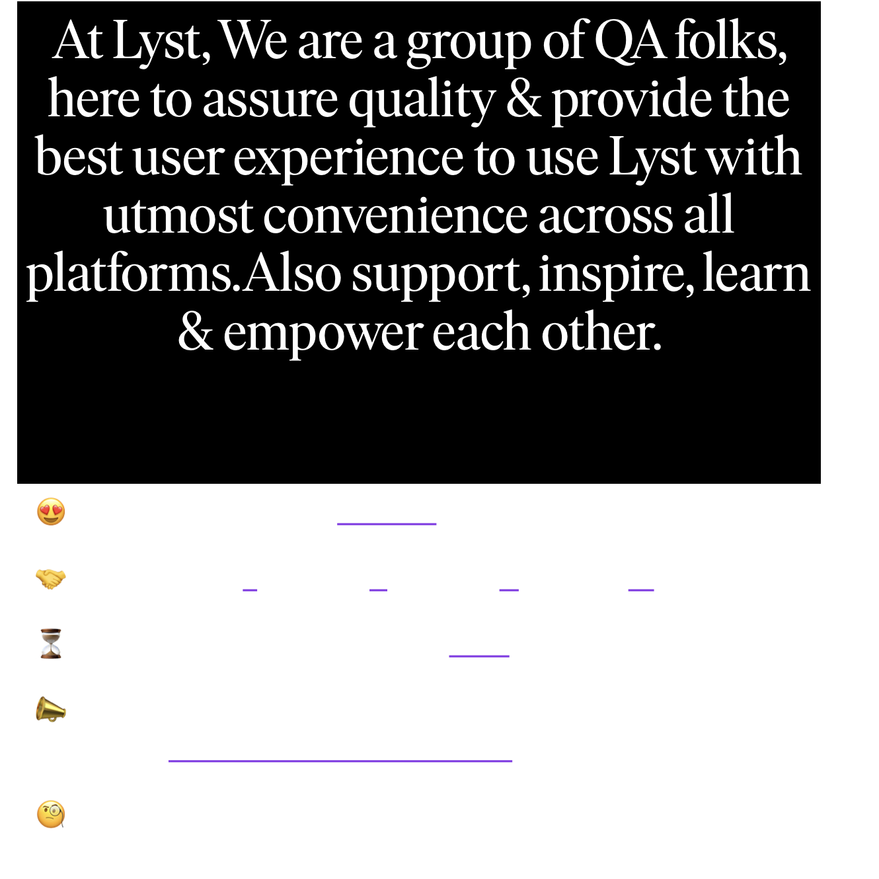

TEAM @app-qa
😍 Passionate (Going beyond what is obvious)
🤝 Team work (Together Everyone Achieves More)
⏳ Quality over speed(Quality NOT Quantity)
📣 Communicative (If something does not work as expected notify as soon as possible)
🧐 Curious (When you are curious, you will find lots of things interesting to do)

Slide 4
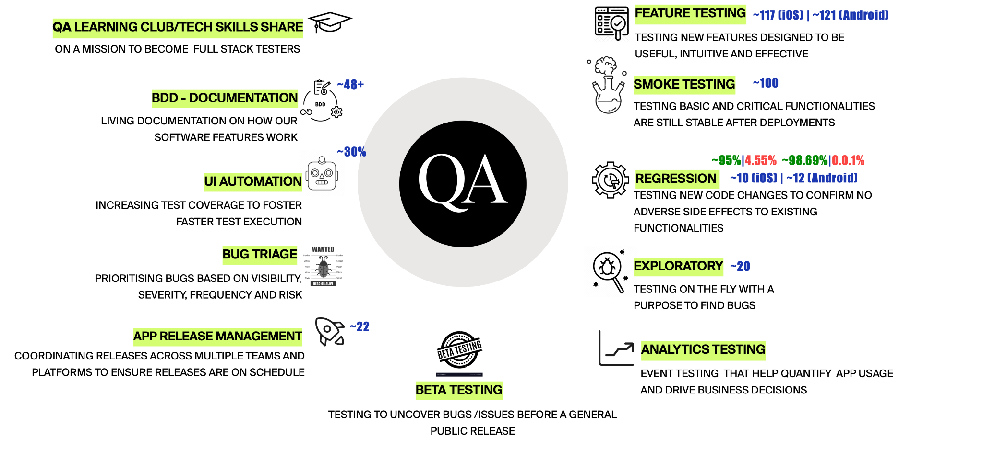
WHAT WE DO?

Slide 5
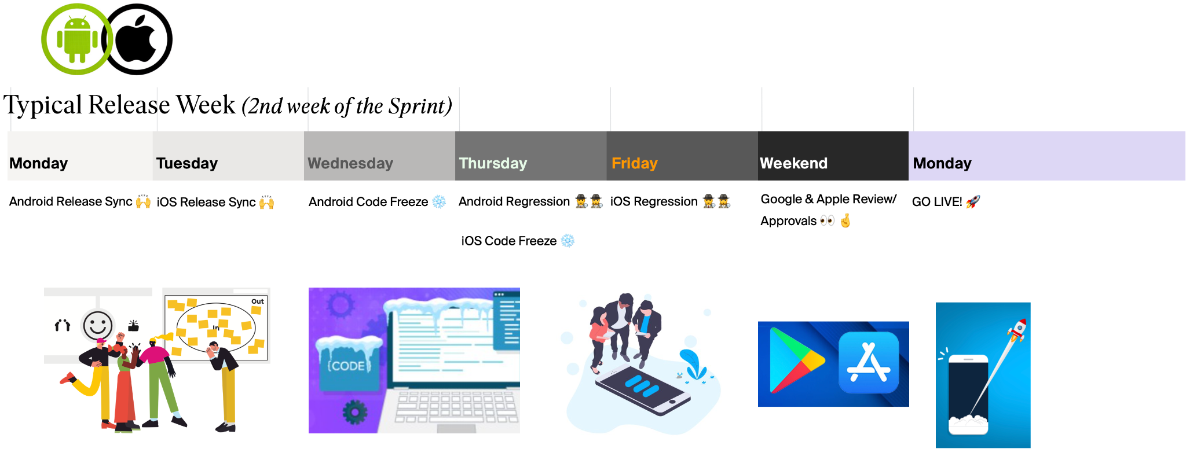
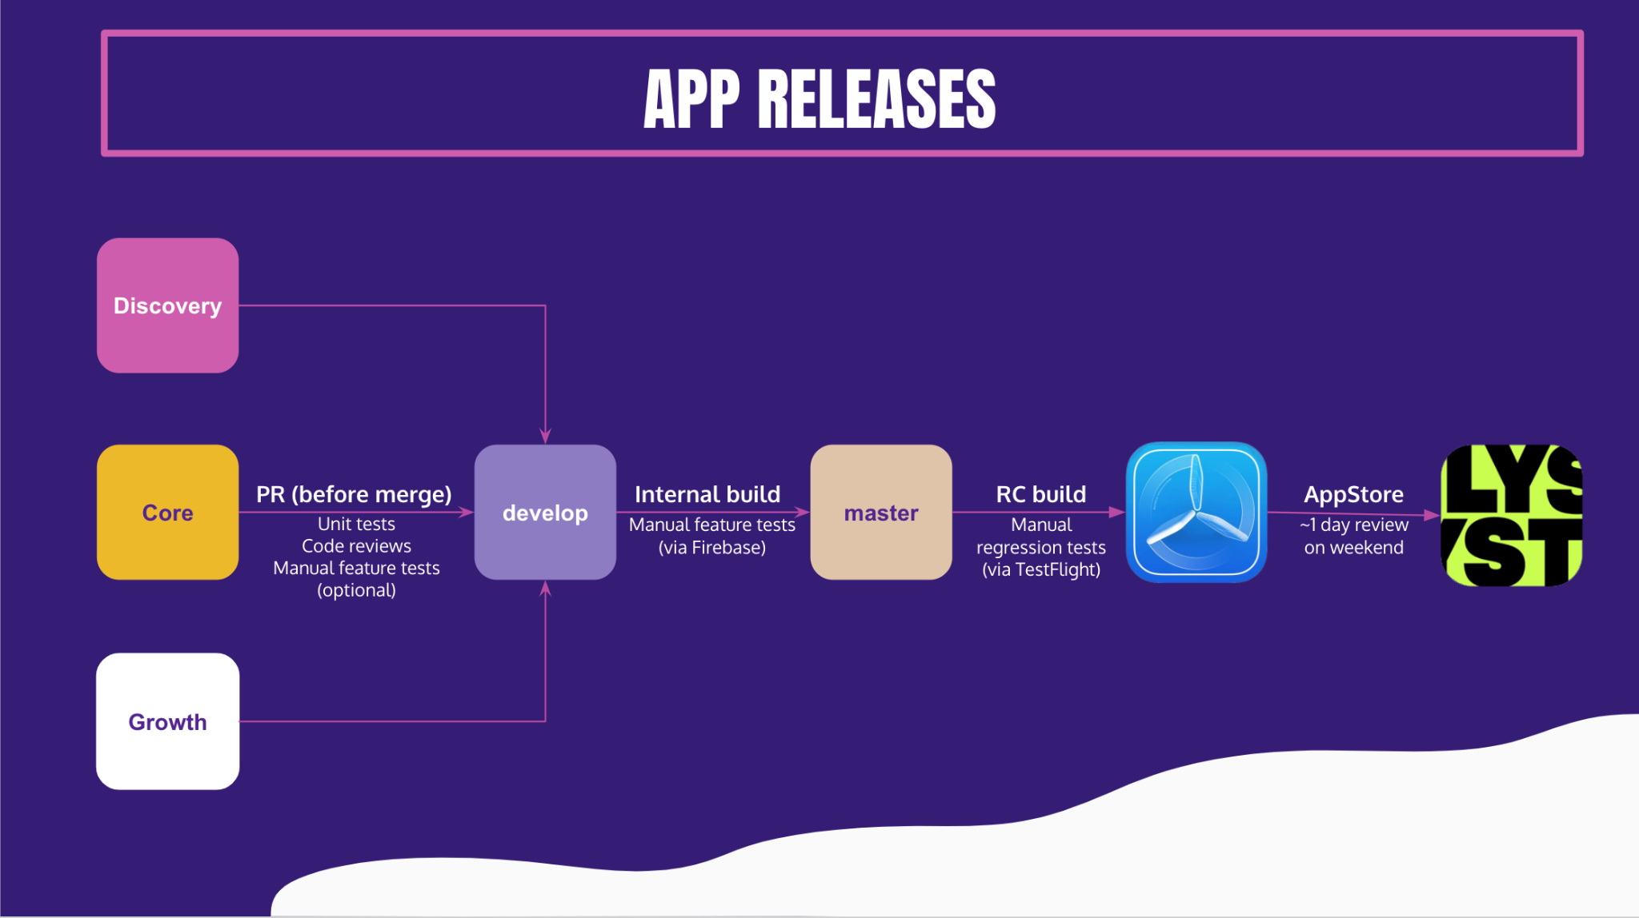
APP RELEASE PROCESS

Slide 6
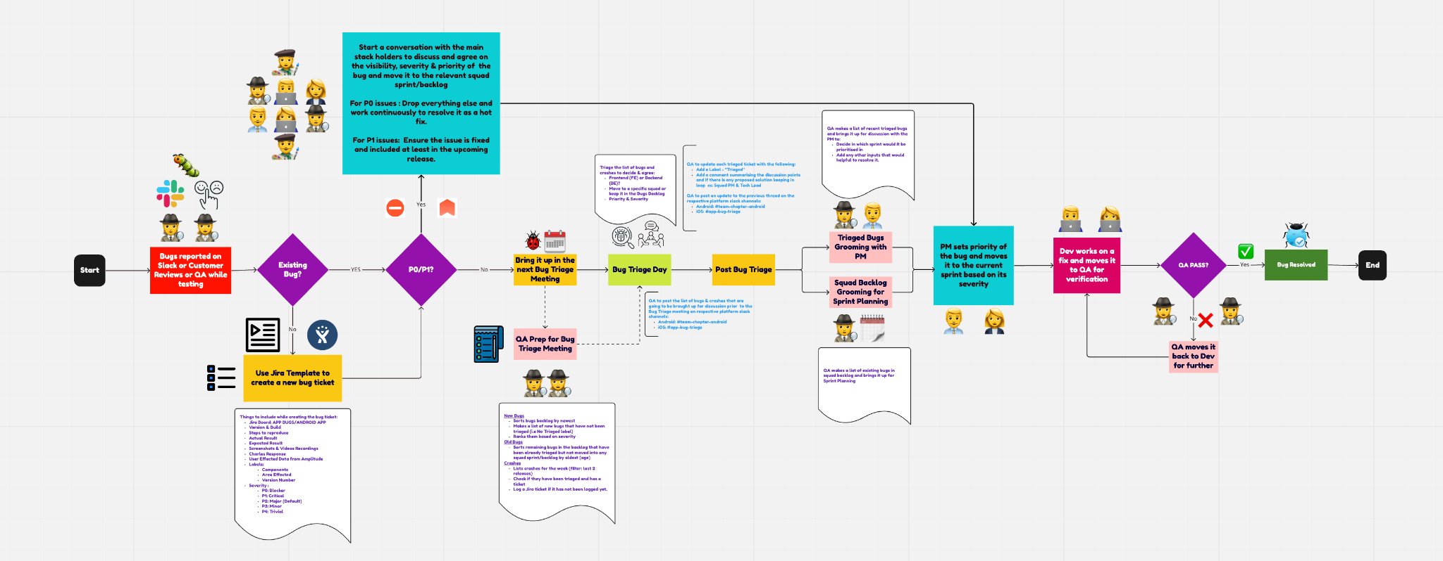
🐛🐞BUG TRIAGE PROCESS

